Slide 1
Excel - Final Assessment

Slide 2
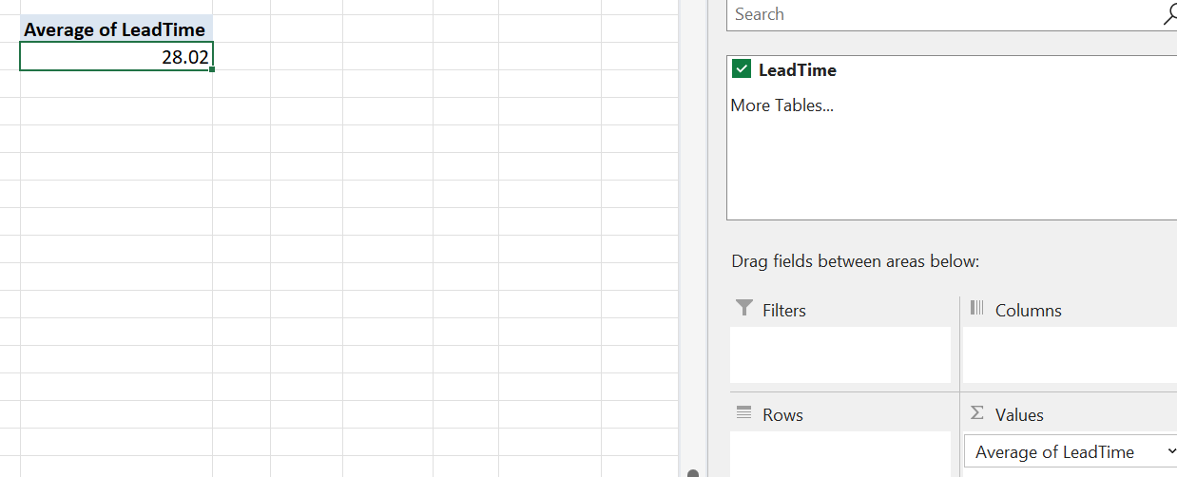

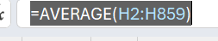
Q1: Average Lead Time between ReqDate and WokDate
First of all, the ReqDate and WorkDate format was corrected and then a column called LeadTime was created next to them which took their difference as it’s input.
Later, a Pivot Table was created to obtain the LeadTime column’s Average and the average was obtained.
The builtin method could’ve also been used

Slide 3

Q2: District with highest number of Rush Jobs
A pivot table was created with Districts in Rows and Count of Rush in Values and the above answer was found where the Northwest District had the Highest number of Rush Jobs with a count of 45.

Slide 4
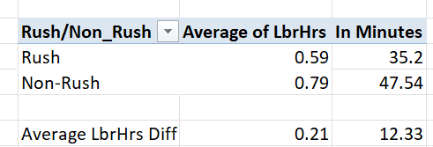
Q3: Avg LbrHrs b/w Rush and Non-Rush
As we can see, Non-rush work takes more time on an average basis when compared to Rush work.
There’s a difference of 12 minutes and 25 seconds between the averages of Rush and Non-Rush work

Slide 5
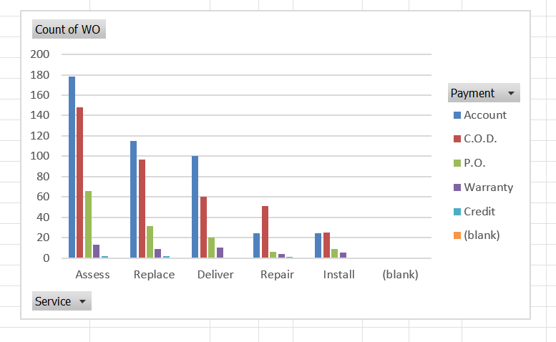
Q4: Payment Types Distribution over services
In Assessment, Replacement and Delivery, preferred payment type is through an account.
For repair work, it’s Cash on Delivery.
The more hands-on work it gets the people prefer cash over account payment.

Slide 6
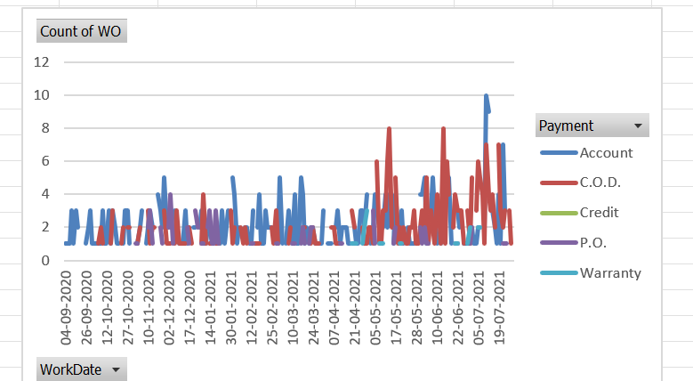
Q5: Trends in Payment Type Distribution

Slide 7

Q6: Relation between Techs and PartsCost
There isn’t a strong relation between the two, it’s moderately positive relationship not strongly positive

Slide 8
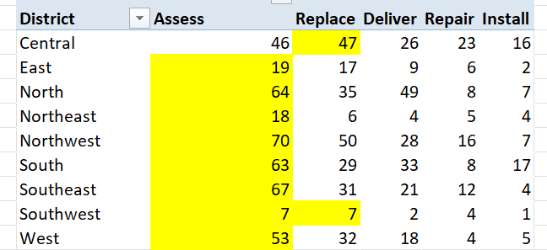
Q7: Most common service in each district
A pivot chart was plotted between Districts in Rows and Services in Columns and values. Consequently, each district’s most common service was highlighted

Slide 9
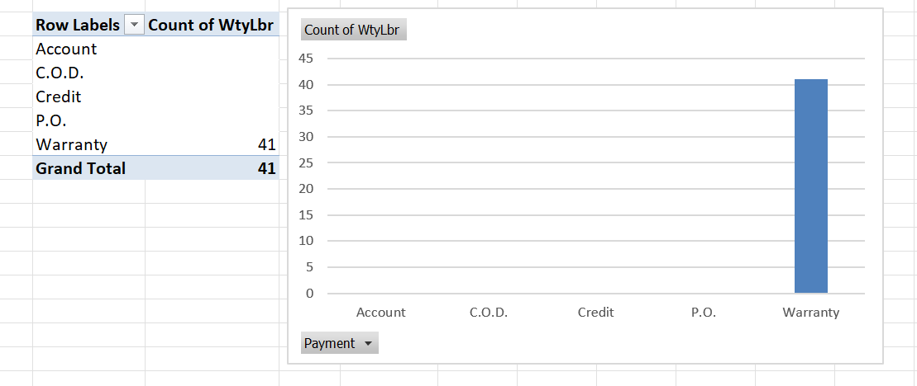
Q8: Diff in Distribution of Payment with WtyLbr
Under warranty, no payment was needed to be made

Slide 10
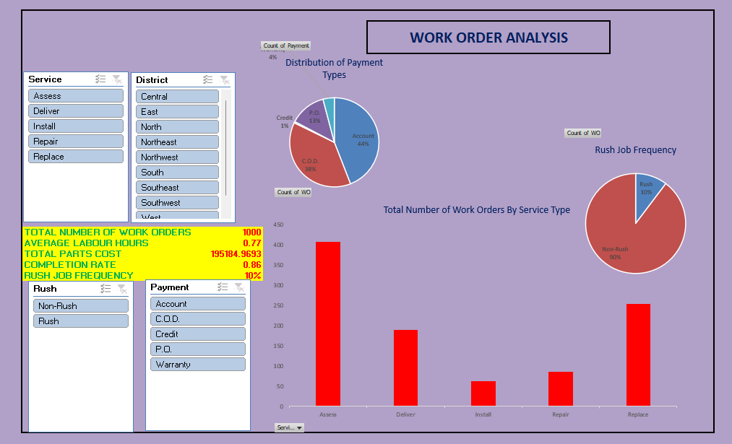
Dashboard

